Slide 1
Distributed Renewable Integration Stability Forecasting
Final demo presentation: NASA POWER weather data, RVSI stability risk, and an interactive dashboard
~89k
hourly records
10 yrs
2015-2025 data
4
risk classes
1/6

Slide 2
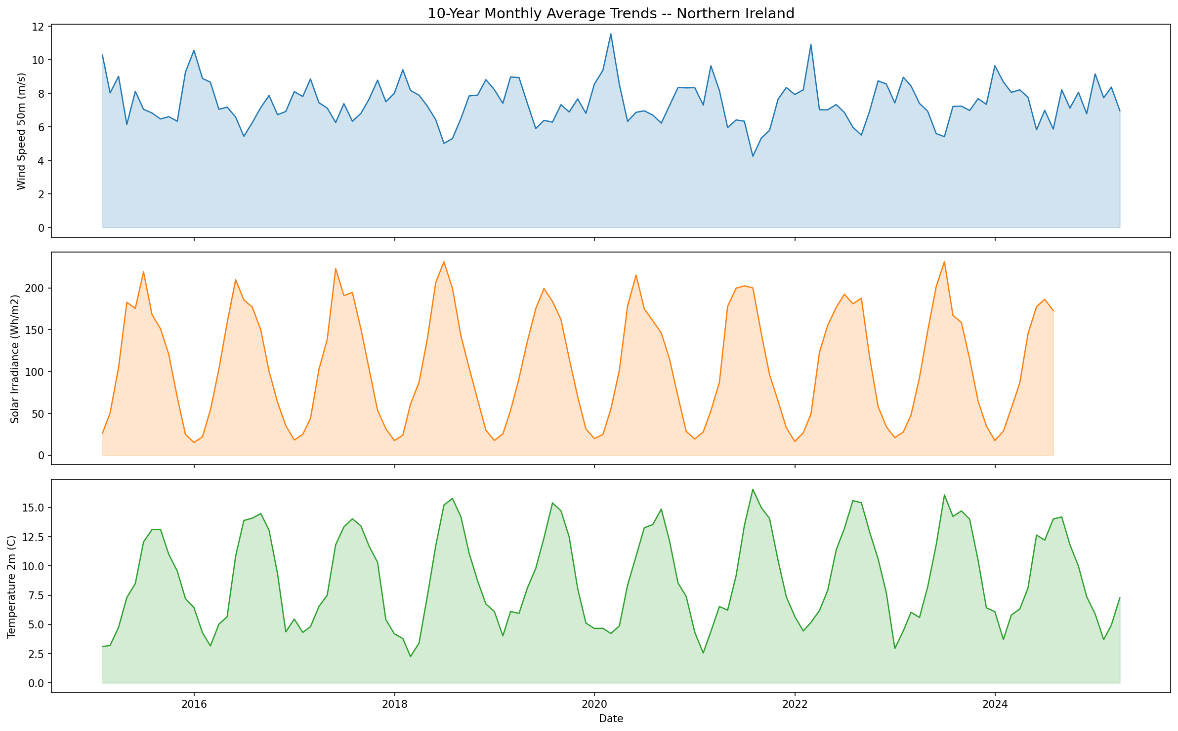
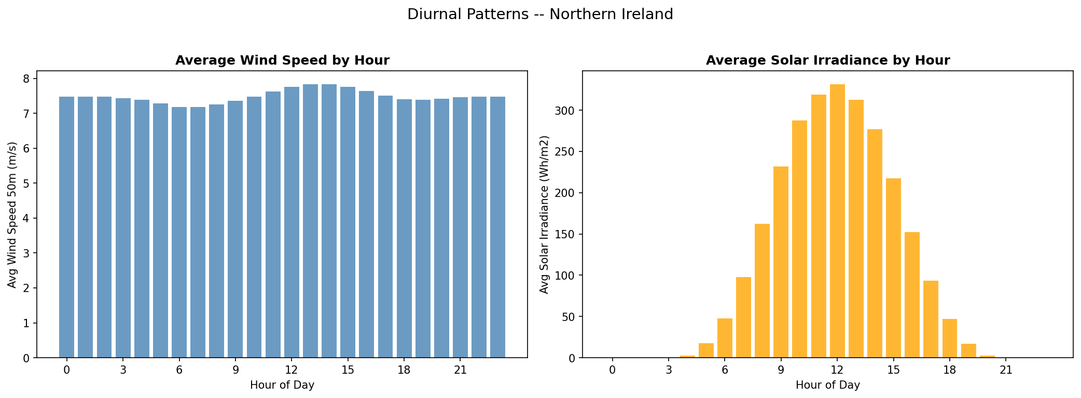
Background And Motivation
Renewable energy is clean, but its output is weather-driven and variable
• Wind speed and solar irradiance can change sharply within hours.
• Grid operators need early warning before renewable volatility becomes instability.
• Northern Ireland is a strong case study because wind generation is important to the grid.
Impact
imbalance and frequency risk
Need
fast stability risk signal
Output
Low to Critical risk class
2/6

Slide 3
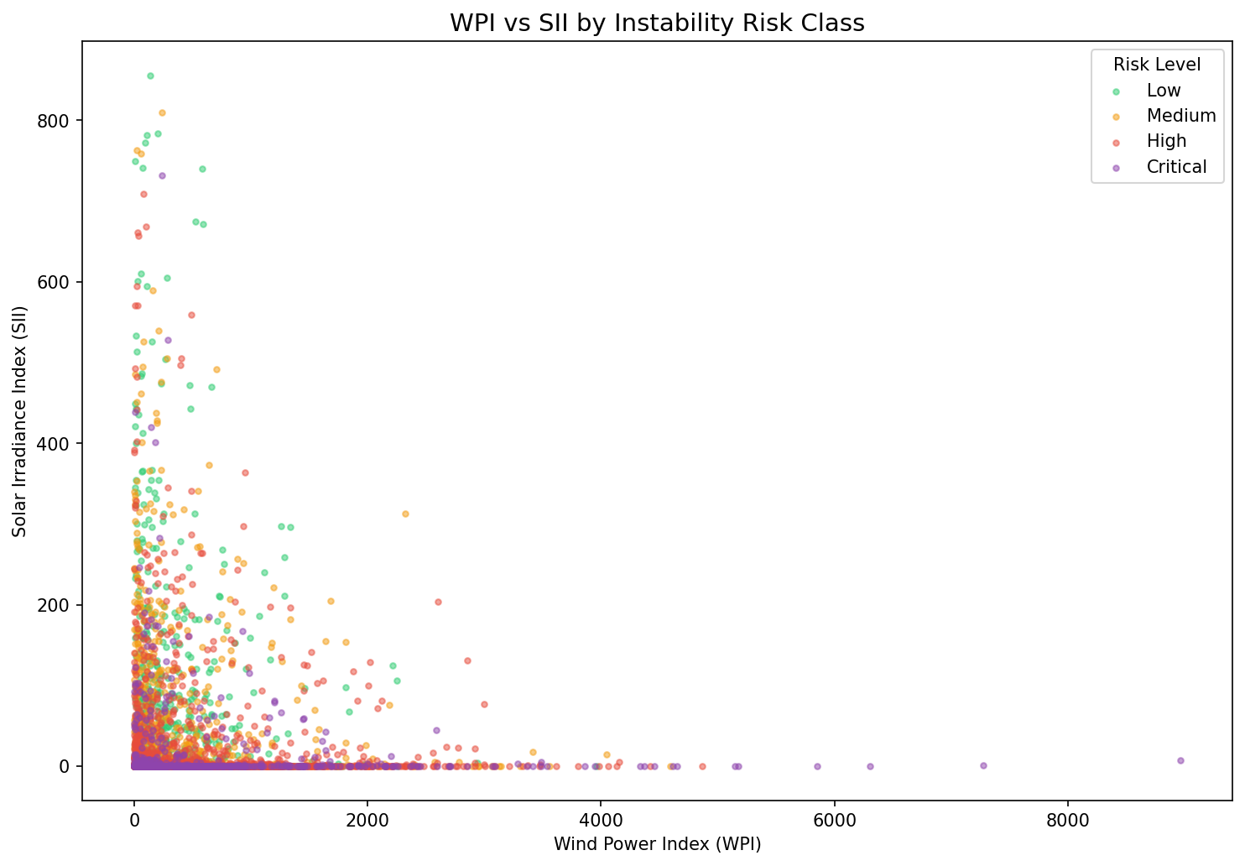
Concept And Objectives
Convert weather observations into a practical grid-stability warning signal
Weather variables
WPI + SII indices
RVSI metric
ML / time series
Risk + dashboard
Main objectives
• Estimate wind and solar generation potential.
• Build a custom Renewable Volatility Stress Index.
• Classify instability risk into Low, Medium, High, and Critical.
• Expose results through a dashboard and API for demonstration.
3/6

Slide 4
Implementation And Technologies
A modular, cluster-ready pipeline with precomputed outputs for the final demo
Raw CSV
Spark ETL
Parquet HDFS sim
Features + labels
Models
Dashboard + API
Layer | Technology | Purpose
Processing | PySpark | clean, validate, transform
Storage | Parquet | partitioned fast reads
Modeling | RF, GBT, SARIMA, LSTM | forecast and classify
Interface | Flask, Streamlit | live demo and results
Challenges handled
Missing values
NASA -999 sentinels converted to nulls
Time features
hour, month, lags, rolling windows
Long runtime
saved plots, parquet, and trained outputs
Scalability
Spark design can move to a cluster
4/6

Slide 5
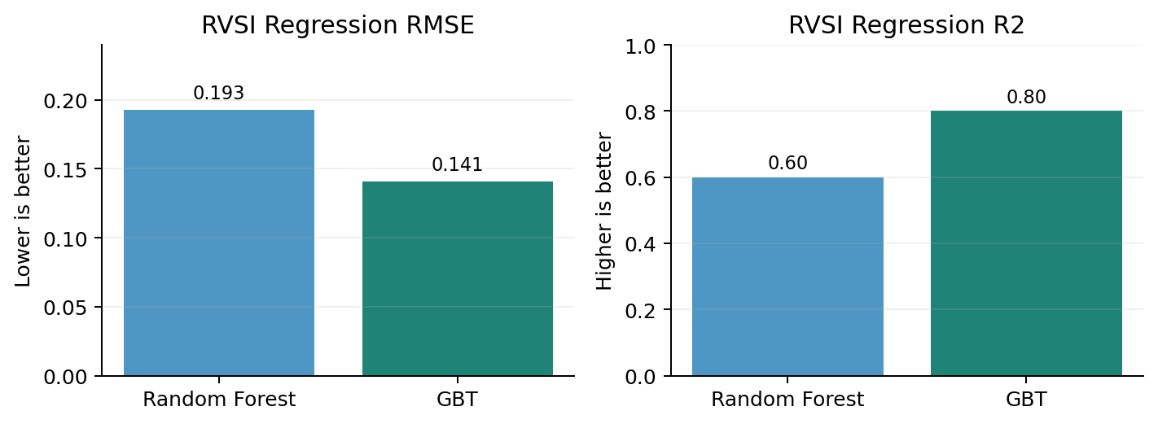
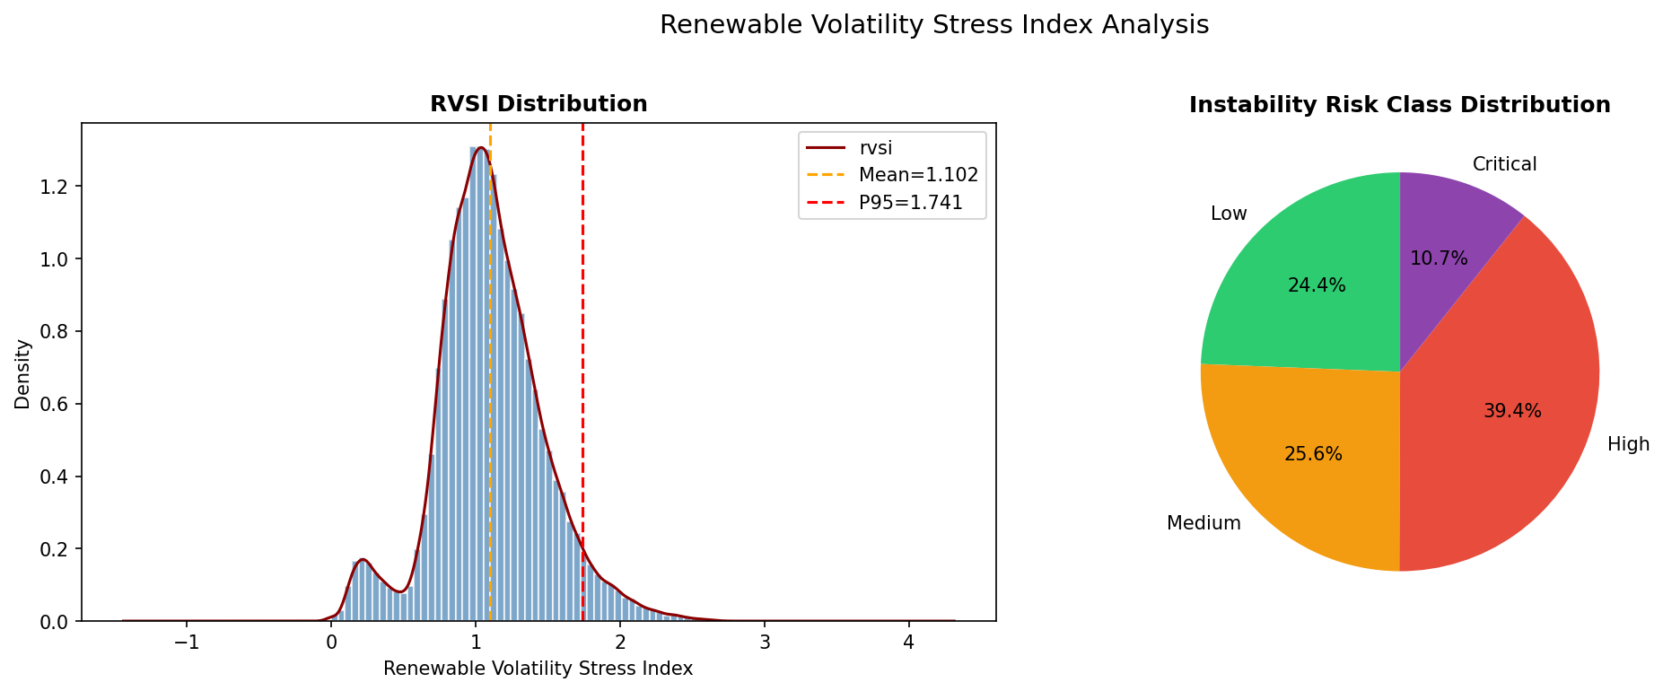
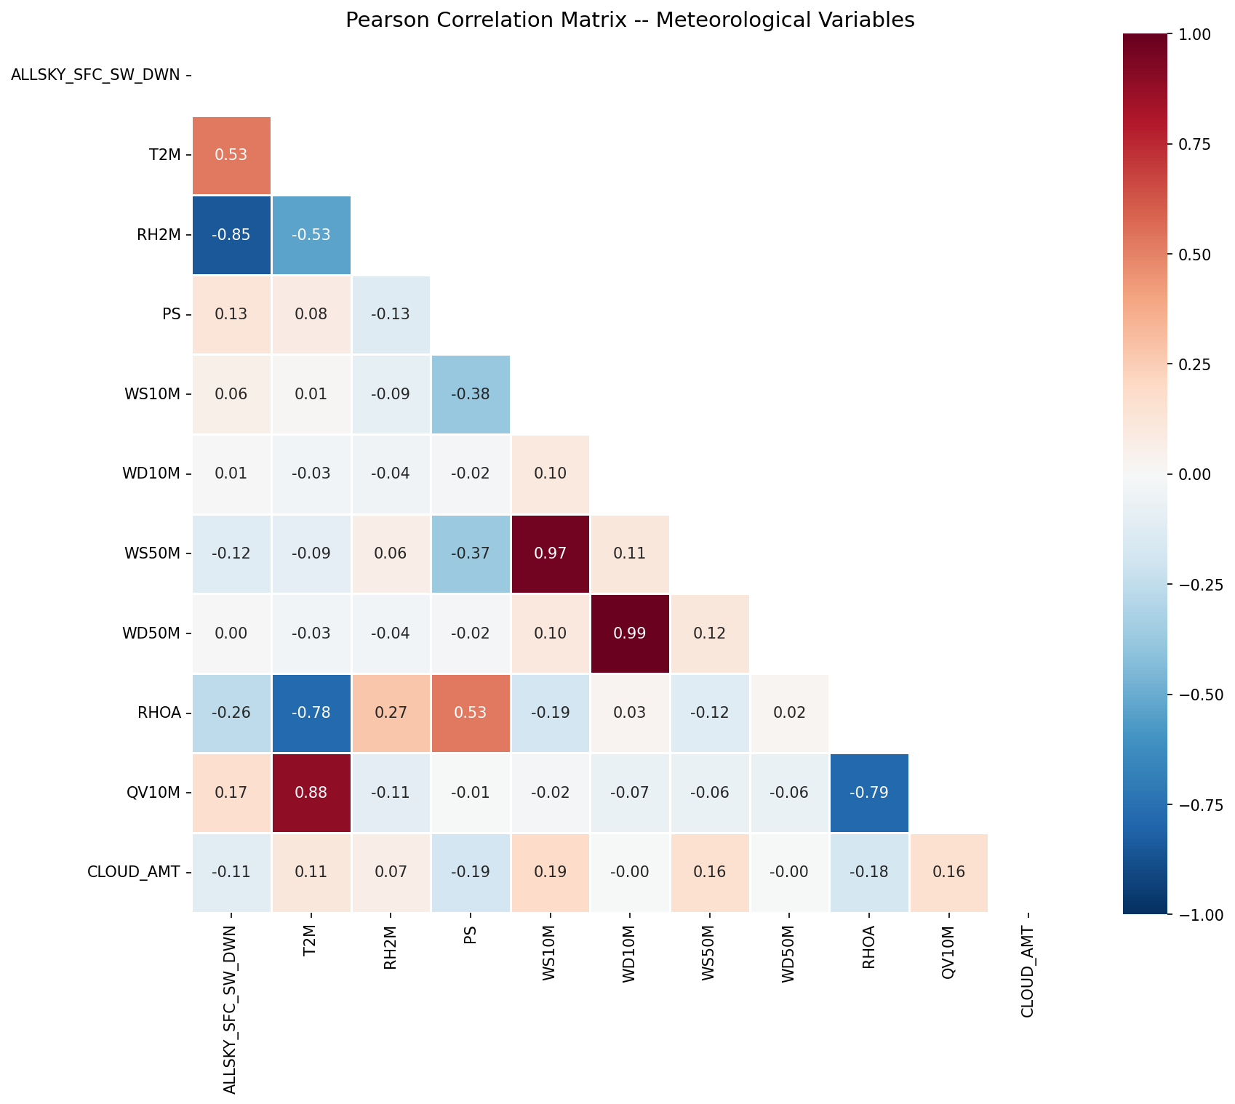
Results And Evaluation
Model outputs and visual analysis are precomputed for a smooth demonstration
• GBT regression: RMSE around 0.14, R2 around 0.80.
• Risk classifiers: accuracy/F1 around 85%+.
• RVSI separates low and high volatility periods for the dashboard.
5/6

Slide 6
Demo Storyline And Future Work
Keep the slides short, then spend most time showing the working system
1. Dashboard
2. Prediction
3. Code
Before demo
• Show Overview, EDA, Risk Analysis, and Interactive Forecast.
• Use one weather input and explain WPI, SII, RVSI, and risk class.
• Open src modules, API, dashboard, tests, and saved model folders.
• Keep long jobs pre-run.
• Open PPT, dashboard, API, and notebook.
• Practice once with a timer.
Future work
• Spark Structured Streaming for live sensor data.
• Multi-region UK and Ireland forecasting.
• Cloud deployment and real grid validation.
6/6

